Slide 1
Net 222: Communications and networks fundamentals (Practical Part)
Tutorial 3

Slide 2
Plan ☺
This Week 8 | tutorial 2
Week 9 | tutorial 3
Week 10 | lab 4,5 + revision
Week 11 | Evaluation 2 on lab 4,5
Week 12 | Quiz tutorial 1 , 2 , 3

Slide 3
Q 1
Assume a data stream is made of ten alternate 0’s & 1’s. Encode this stream, using the following encoding schemes.
Unipolar,
NRZ-L,
NRZ-I,
Manchester,
Differential Manchester

Slide 4
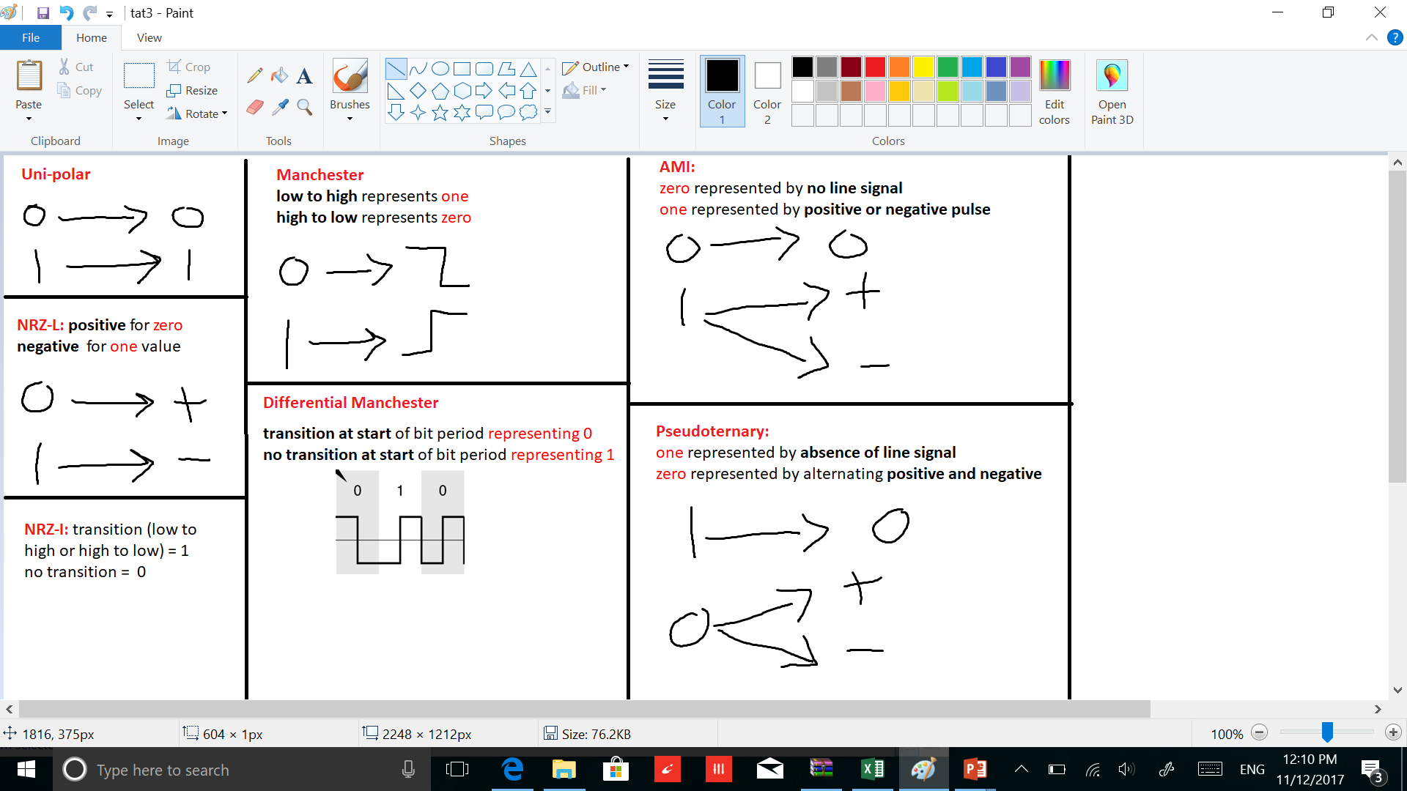
Rules

Slide 5
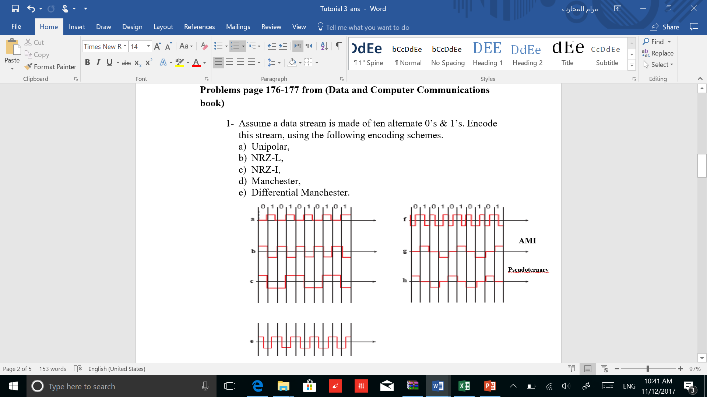
S 1

Slide 6
Q 2
Sketch the signal waveforms when 00110101 is transmitted in the following signal codes.
i) NRZ – L ii) Manchester Code

Slide 7
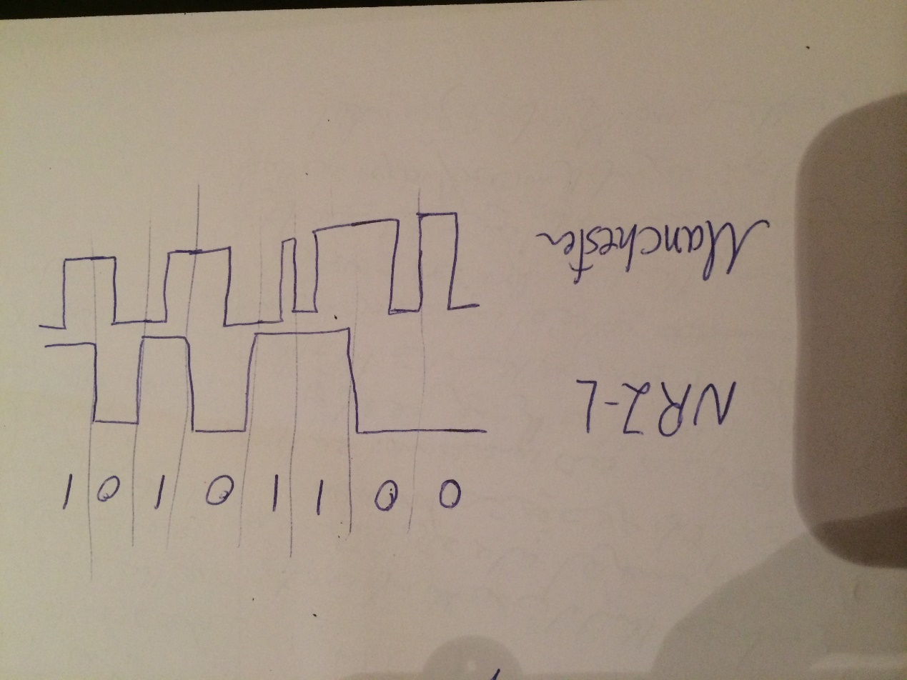
S 2

Slide 8
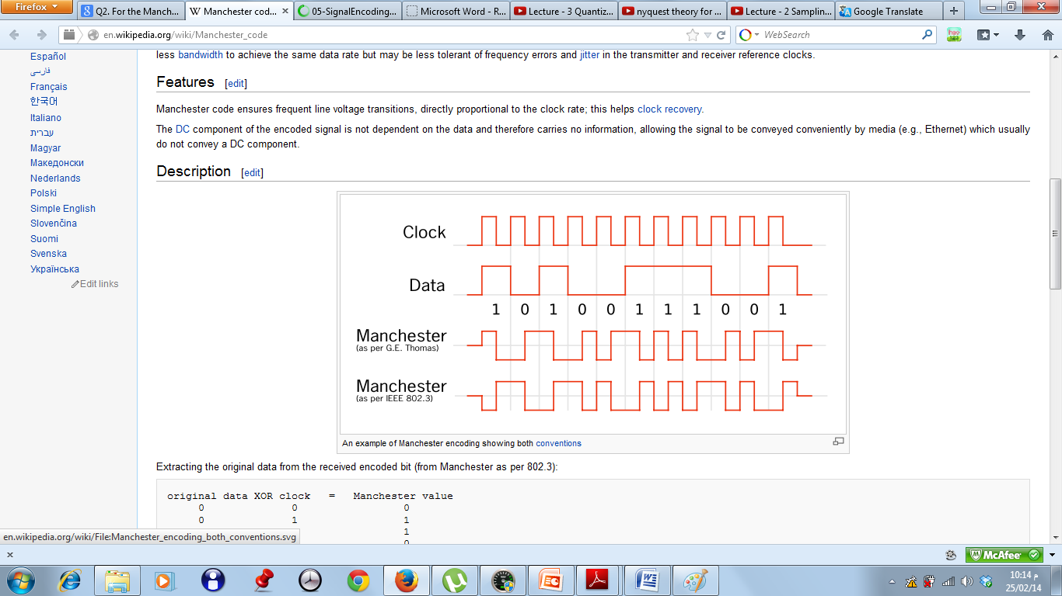
Q3
For the Manchester encoded binary stream of the following, extract the clock information and the data sequence.

Slide 9
S3
1 0 1 0 0 1 1 1 0 0 1

Slide 10
Q4
The analog waveform shown in the following figure is to be delta modulated. The sampling period and the step size are indicated by the grid. The first DM output is also shown. Give the DM output for the complete signal.

Slide 11
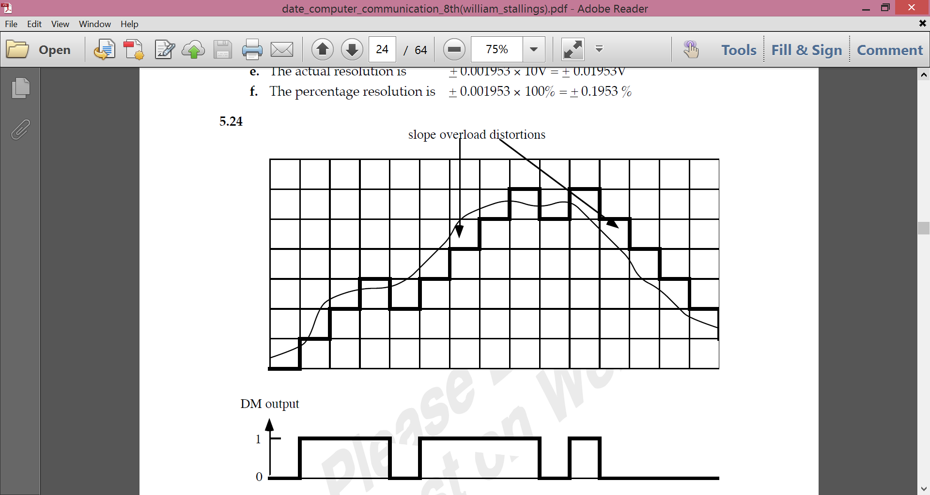
S4

Slide 12
Q5
Given the bit pattern 101001000011, encode this data using MFSK assume each signalling element represents with 3-bits. ?

Slide 13
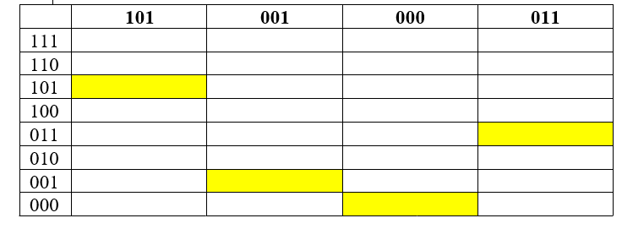
S5
Answer :
2^3 , M= 8

Slide 14
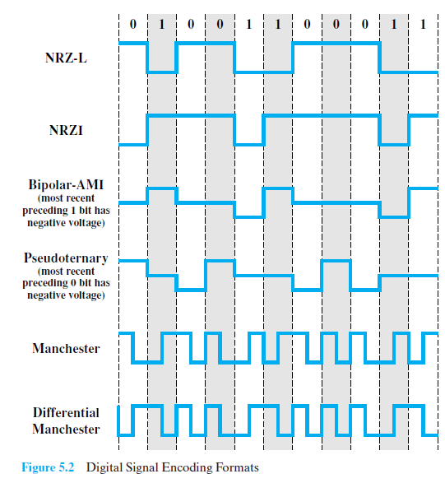
Q 5.1
Which of the signals of Table 5.2 use differential encoding

Slide 15
S6
Answer: NRZI, Differential Manchester.

Slide 16
Q 5.11
Given the bit pattern 01100, encode this data using ASK, BFSK, and BPSK.

Slide 17
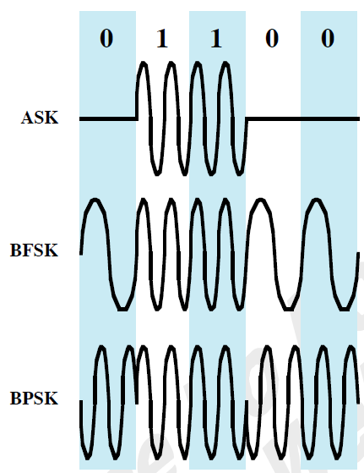
S 5.11

Slide 18
The End
Any Questions ?

